Slide 1

(ADHD) Mental Health analysis of the university students using MS Excel and Power BI tools
Data Source : Kaggle
Data analysis project by:
Kavita Shinde

Slide 2

About Dataset
Dataset updated : 5th Jan.2024
Dataset provided by The University of Cape Town
Description: A sample data of 506 South African first-year undergraduate students
(age 18-22 years) to investigate:
The number of students who have experienced mental health difficulties before starting University.
The number of students who had been to a therapist.
The number of students who had been diagnosed with a mental illness, and
The number of students who had been prescribed medication for their mental illness.
Analysis done age-wise as well as gender-wise to improve the student's academic performance.

Slide 3
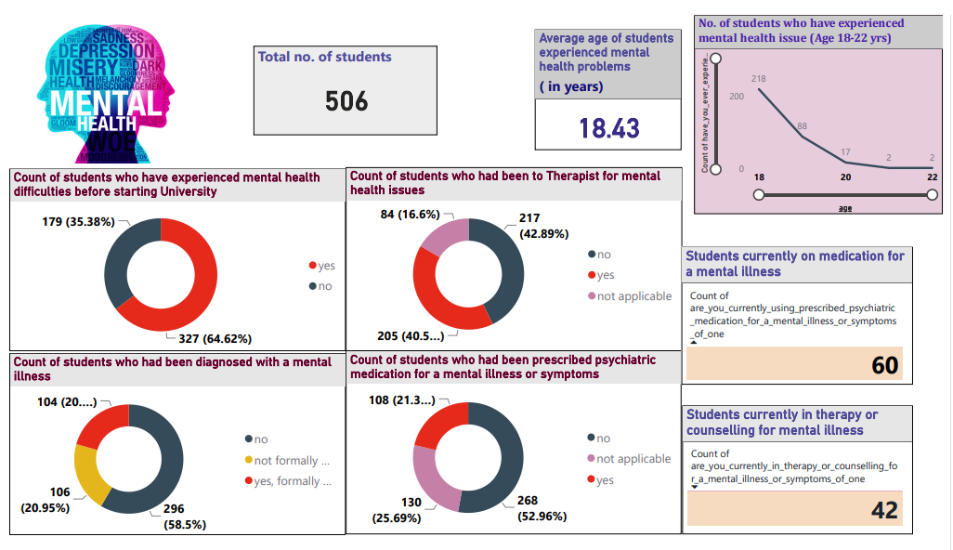
Power BI analysis report

Slide 4
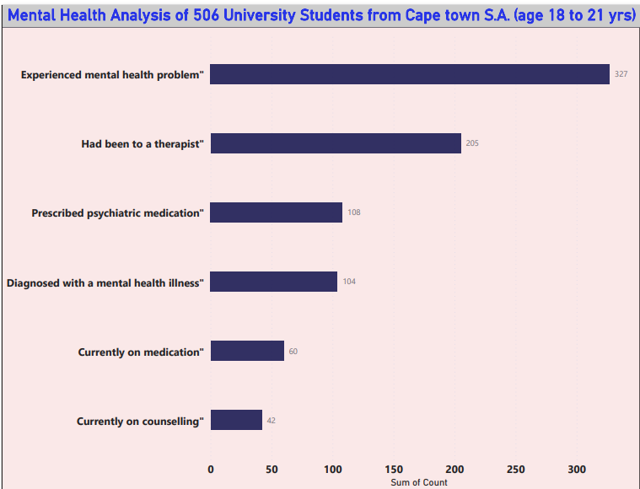
Power BI analysis bar chart

Slide 5
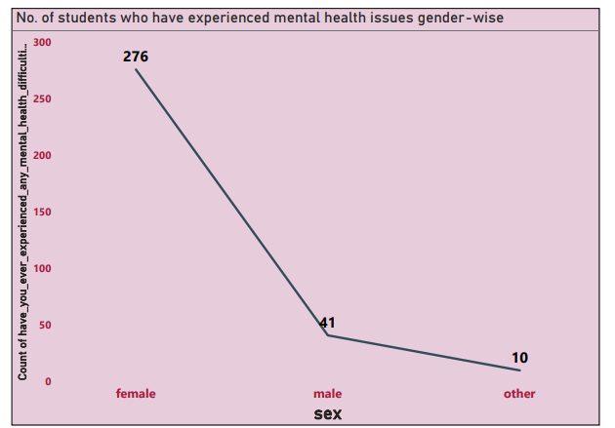
Gender-wise analysis in Power BI chart showing no. of University students who experienced mental health problems.

Slide 6
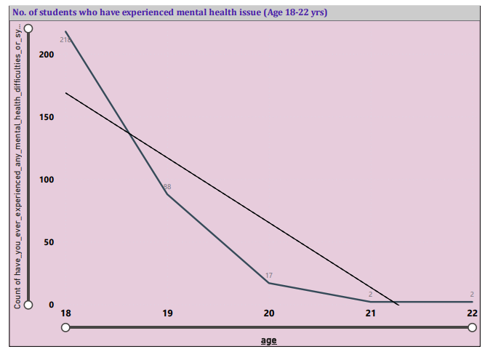
Age-wise analysis in Power BI chart showing no. of university students experienced mental health problems.

Slide 7
Conclusion :
The ADHD ( Attention Deficit/Hyperactivity disorder) data analysis shows the following observations:
Students in the first year of the university are more likely to experience mental health difficulties and symptoms.
Age-wise analysis showed that students age between 18 and 19 year experience more mental health problems.
Gender-wise analysis showed that a greater number of female students have experienced this problem more compared to male and others.
64% students have experienced mental health difficulties, out of which 20% had been diagnosed with a mental illness. 40% had been to a therapist and 21% had been prescribed with a psychiatric medicine.

Slide 8
Possible Reasons :
According to BMC (Bio-Med Central ) Public Health article, it is observed that the following factors might trigger the mental health of students who have newly started going to university:
Study and work pressure
Home sickness
Loneliness
Bullying
Money worries and
Relationship trouble
The reason behind female students experiencing more mental health issues as compared to male could be due to familial responsibilities or sexism.
Older age groups may cope better due to emotion-regulation strategies improving with age.

Slide 9
Solution:
According to the BMC (Bio-Med Central) Public Health article, the following factors could reduce the risk of mental health difficulties amongst first year university student:
Engaging in learning activities: Strongly and positively associating with characteristics of adaptability, happiness and wellbeing.
Good induction activities: Positively and strongly associating with a sense of community at university and with lower levels of loneliness.
Leisure activities: To manage stress, facilitate the development of companionship, and enhancing mood are positively associated with flourishing.
Friendship: Important for maintaining mental health and provide opportunities to be developed and supported.
Counselling: Counselling can help identify unhelpful patterns or thought processes that can hold you back and prevent you from making progress and moving forward.
Project : Kavita Shinde

